Slide 1
Real-time Analytics End-to-End Workshop
Develop a complete Microsoft Fabric solution leveraging real-time analytics, data warehousing, data lakehouse, Data Activator, data science, and Power BI.

Slide 2

01
Welcome and Schedule
Content
02
Microsoft Fabric Overview
03
Fabric Workshop
04
Wrap-up, Q&A, Feedback

Slide 3
Welcome

Slide 4
Full Day Schedule
Module 0 9:00-9:30 AM
Solution overview and initial setup
Module 1 & 2 9:30-10:15 AM
Module 3 10:15 – 10 :45 AM
Lunch Break 11:30 – 12:30 PM
Module 5 12:30pm – 2:00 PM
Module 6 2:00-3:00 PM
Module 7 3:15-4::30 PM
KQL Databases and KQL Querysets
Power BI Real-time Reports
Synapse Data Warehouse and pipelines
Data Lakehouse with notebooks
Data Science – Building ML models
Break and Review 10:45 – 11:00 AM
Module 4 11:00 – 11:30 AM
Data Activator
Break and Q&A 3:00 – 3:15
Closing 4:30 – 4:45 PM
Feedback and next steps
Notes:
Example full day schedule

Slide 5
Half Day Schedule
Modules 1-3 9:00 – 10:00 AM
Solution Overview
Setup
Module 6
10:00 – 11:00 AM
Module 7
11:00 – 12:30 PM
Closing 12:30pm – 1:00 PM
Module 6: Lakehouse
Data Science
Q&A, Feedback, and next steps
Medallion Architecture, notebooks, and data wrangler
Build ML models to predict stock prices
Notes:
Example half day schedule

Slide 6
3 Day Lunch & Learn
Day 1 Modules 1-3
Setup, KQL, Reports
Day 2 Module 6
Day 3 Module 7
Data Science
Lakehouse
Build ML models to predict stock prices
Solution Overview
Medallion Architecture, notebooks, and data wrangler
Notes:
Example 3-day lunch and learn schedule

Slide 7
Logistics
Subtitle
Click to edit
Notes:
Include any specific logistics – access to lab environments, if available, trial (https://learn.microsoft.com/en-us/fabric/get-started/fabric-trial), etc.

Slide 8
Microsoft Fabric Overview

Slide 9





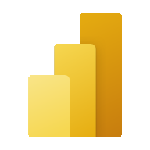


Microsoft Fabric does it all—in a unified solution
An end-to-end analytics platform that brings together all the data and analytics tools that organizations need to go from the data lake to the business user
Data Integration
Data Engineering
Data Warehouse
Data Science
Real Time Analytics
Business Intelligence
Observability
Data Factory
Synapse
Synapse
Synapse
Synapse
Power BI
Data Activator
Unified data foundation
OneLake
UNIFIED
SaaS product experience
Security and governance
Compute and storage
Business model

Slide 10









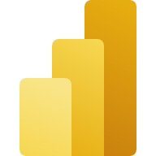



Empower your data professionals to move faster and unlock more value from your data
Data Engineers
Data Scientists
Data Analysts
Data Citizens
Execute faster with the ability to spin up a Spark VM cluster in seconds, or configure with familiar experiences like Git DevOps pipelines for data engineering artifacts
Streamline your work with a single platform to build and operate real-time analytics pipelines, data lakes, lake houses, warehouses, marts, and cubes using your preferred IDE, plug-ins, and tools.
Reduce costly data replication and movement with the ability to produce base datasets that can serve data analysts and data scientists without needing to build pipelines
Quickly tune a custom model by integrating a model built and trained in Azure ML in a Spark notebook
Work faster with the ability to user your preferred data science frameworks, languages, and tools
Bypass engineering dependencies with the ability to use your preferred no-code ML Ops to deploy and operate models in production
Tap into proven-at-scale models and services to accelerate your AI differentiation (AOAI, Cognitive Services, ONNX integration, etc).
Avoid slow, progress-stagnating data wrangling by seamlessly triggering a workflow that can unlock data engineering tools and capabilities quickly.
Accelerate your work with visual and SQL based tools for self-serve data transformations and modeling as well as self-serve tools for reporting, dashboards, and data visualizations
Turn data into impact with industry-leading BI tools and integration with the apps your people use everyday like Microsoft 365
Make more data-driven decisions with actionable insights and intelligence in your preferred applications
Maintain access to all the data you need, without being overwhelmed by data ancillary to your role thanks to fine grain data access management controls
Serve data via warehouse or lakehouse
Serve transformed data
Serve insights via embedding
Supporting experiences:
Supporting experiences
Supporting experiences
Supporting experiences
Data Factory
Data Warehouse
Data Science
Azure ML
Data Warehouse
Real-time analytics
Power BI
Power BI
Microsoft 365
Data Engineering
Real-time analytics
Serve data via warehouse or lakehouse
Data Stewards
Maintain visibility and control of costs with a unified consumption and cost model that provides evergreen spend optics on your end-to-end data estate
Gain full visibility and governance over your entire analytics estate from data sources and connections to your data lake, to users and their insights

Slide 11
The Workshop

Slide 12


Scenario Overview
AbboCost Financial is a small firm that monitors several volatile stocks. Their current data feed provides stock prices in real time. This feed is all you have to work with.
Your goal: support the development of this fledgling company by developing a modern data analytics solution.

Slide 13
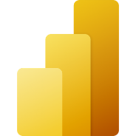
Common Real-time Analytics Patterns
Data Source
Ingestion
Store
Expose
Lakehouse & Data Warehouse
CI & Shortcuts
Kusto DB
PBI
Structured / Unstructured
Pipeline & Dataflows
Kusto Query
Event Streaming
Mirror
Notebook
Lakehouse & Data Warehouse
ML Model
Notes:
Unlike the Data Science, Lakehouse, and Data Warehouse analytics scenarios, streaming data can be ingested into the Microsoft Fabric in several ways to achieve real-time analytics.
Users can leverage Event Hub, IoT Hub, pipelines, dataflows, notebooks, or open-source products like Kafka, Logstash, and more.
Once ingested into the Microsoft Fabric, streaming data can be stored in Kusto DB and mirrored into Lakehouse. After the data has been stored, machine learning models can be trained and tested directly on the Lakehouse with experiments.
Like the other scenarios, business users can analyze and visualize the data with Power BI using the see-through mode or SQL endpoints. Data can also be exposed through KQL or notebooks using Spark.

Slide 14
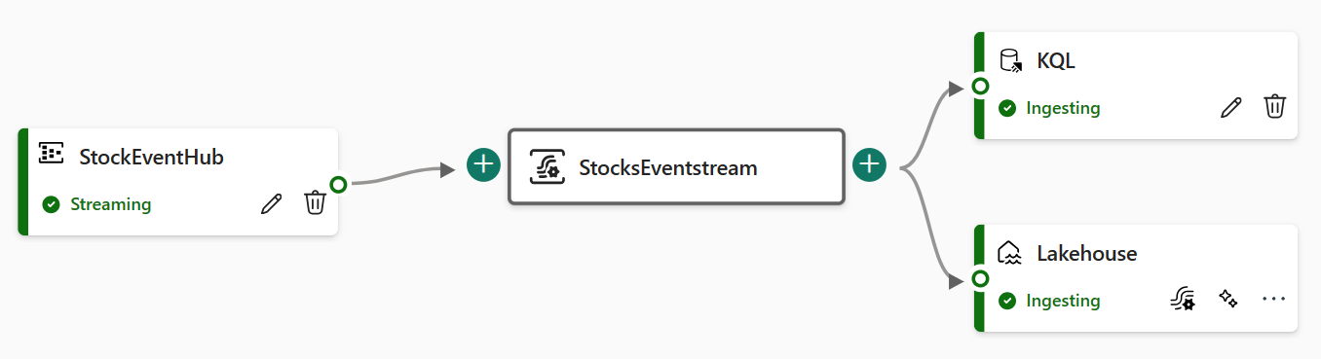
Module 0 – Introduction & Setup
Goals: Understand the solution and deploy the stock price feed generator.
Choice: Decide to deploy the generator as an Azure container or run in a Jupyter notebook.
In general, we recommend deploying as an Azure container if possible, but this requires an Azure subscription.
The data feed will produce 3 pieces of information: stock symbol, current price, and timestamp.

Slide 15
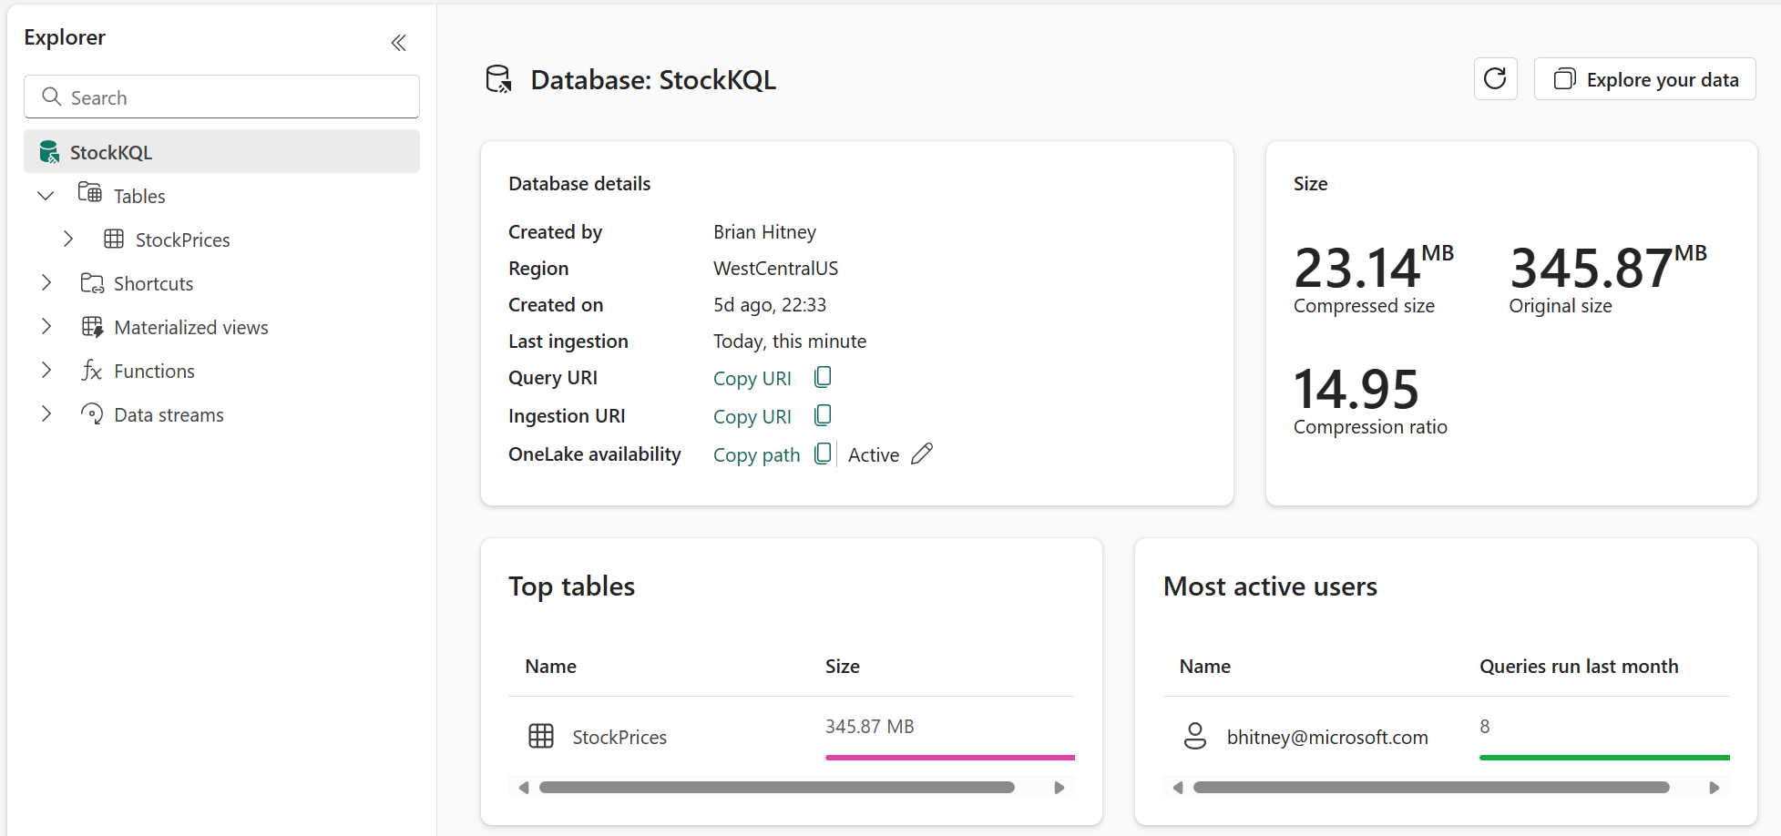
Module 1 – KQL Database Setup
Goals: Create and configure a KQL database to ingest data
With data being fed to the Eventstream, this module focuses on creating and KQL database as a data sink.

Slide 16
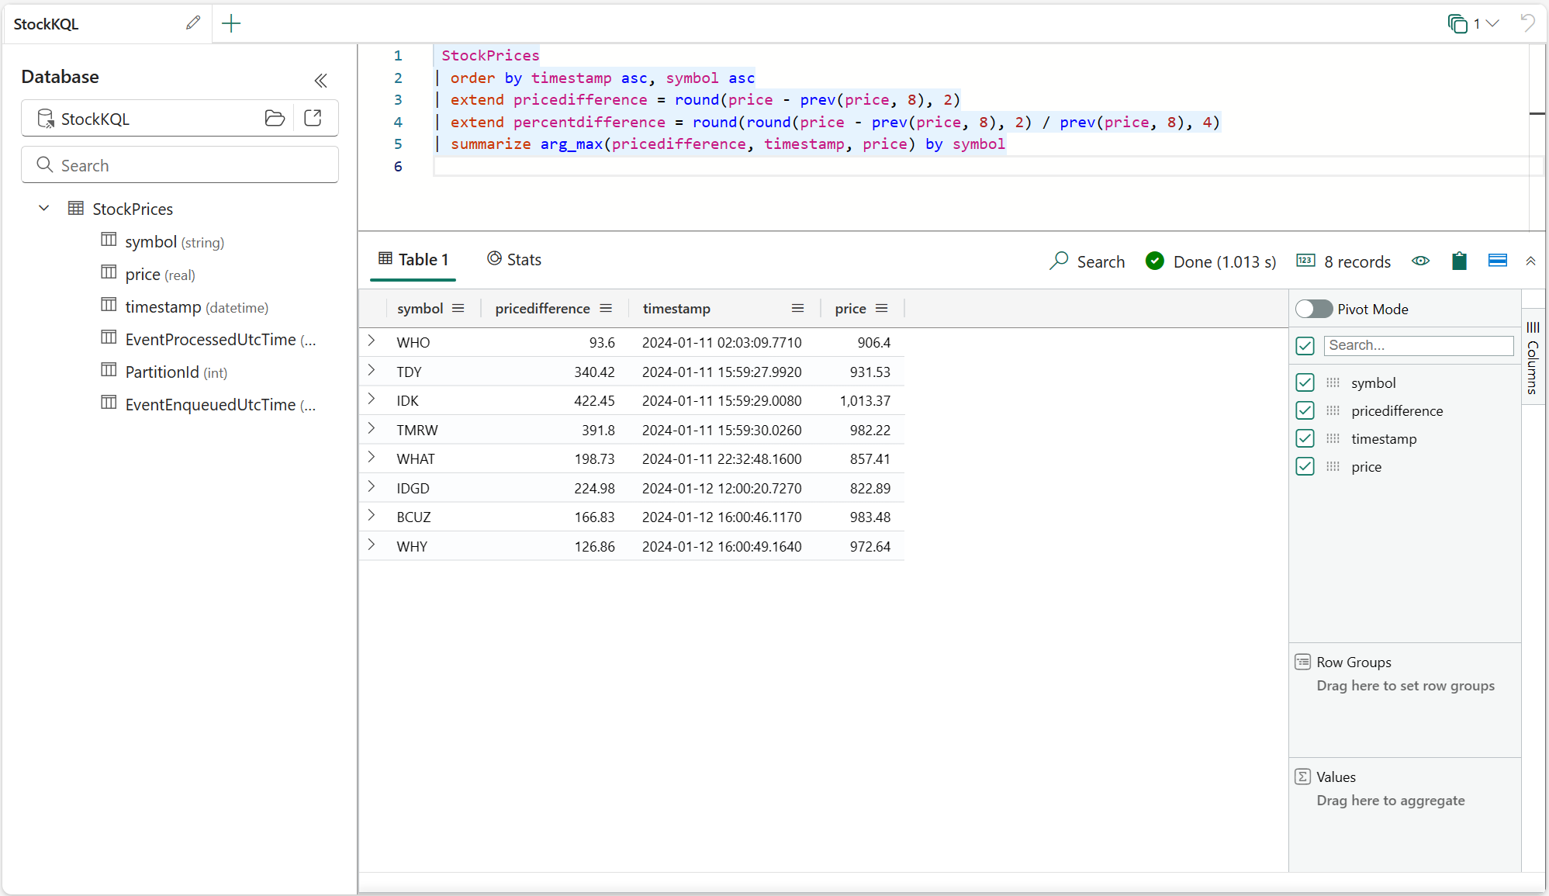
Module 2 – KQL Querysets
Goals: Interact with the underlying data via KQL queries
Begin writing queries to summarize data using Kusto Query Language. Similar to T-SQL, KQL is designed for data exploration and summarization.

Slide 17
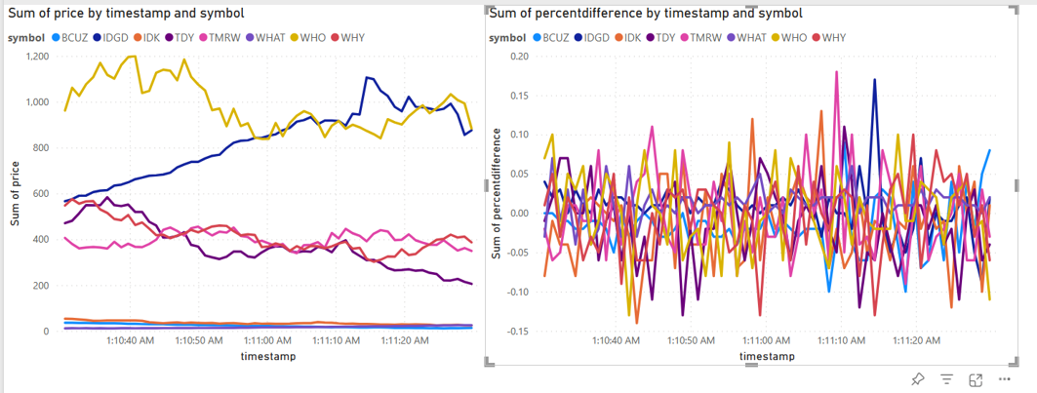
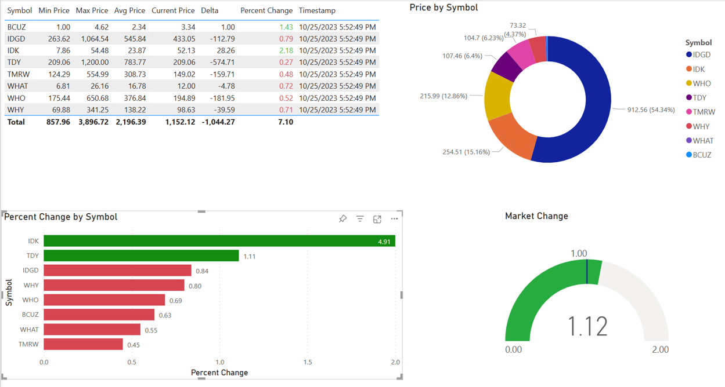
Module 3 – Reports in Power BI
Goals: Build a reports in Power BI to display real-time data.
KQL is the ideal engine to power fast, real-time dashboards. Using a combination of KQL summarizations and Power BI functions, compelling visuals can be created.

Slide 18
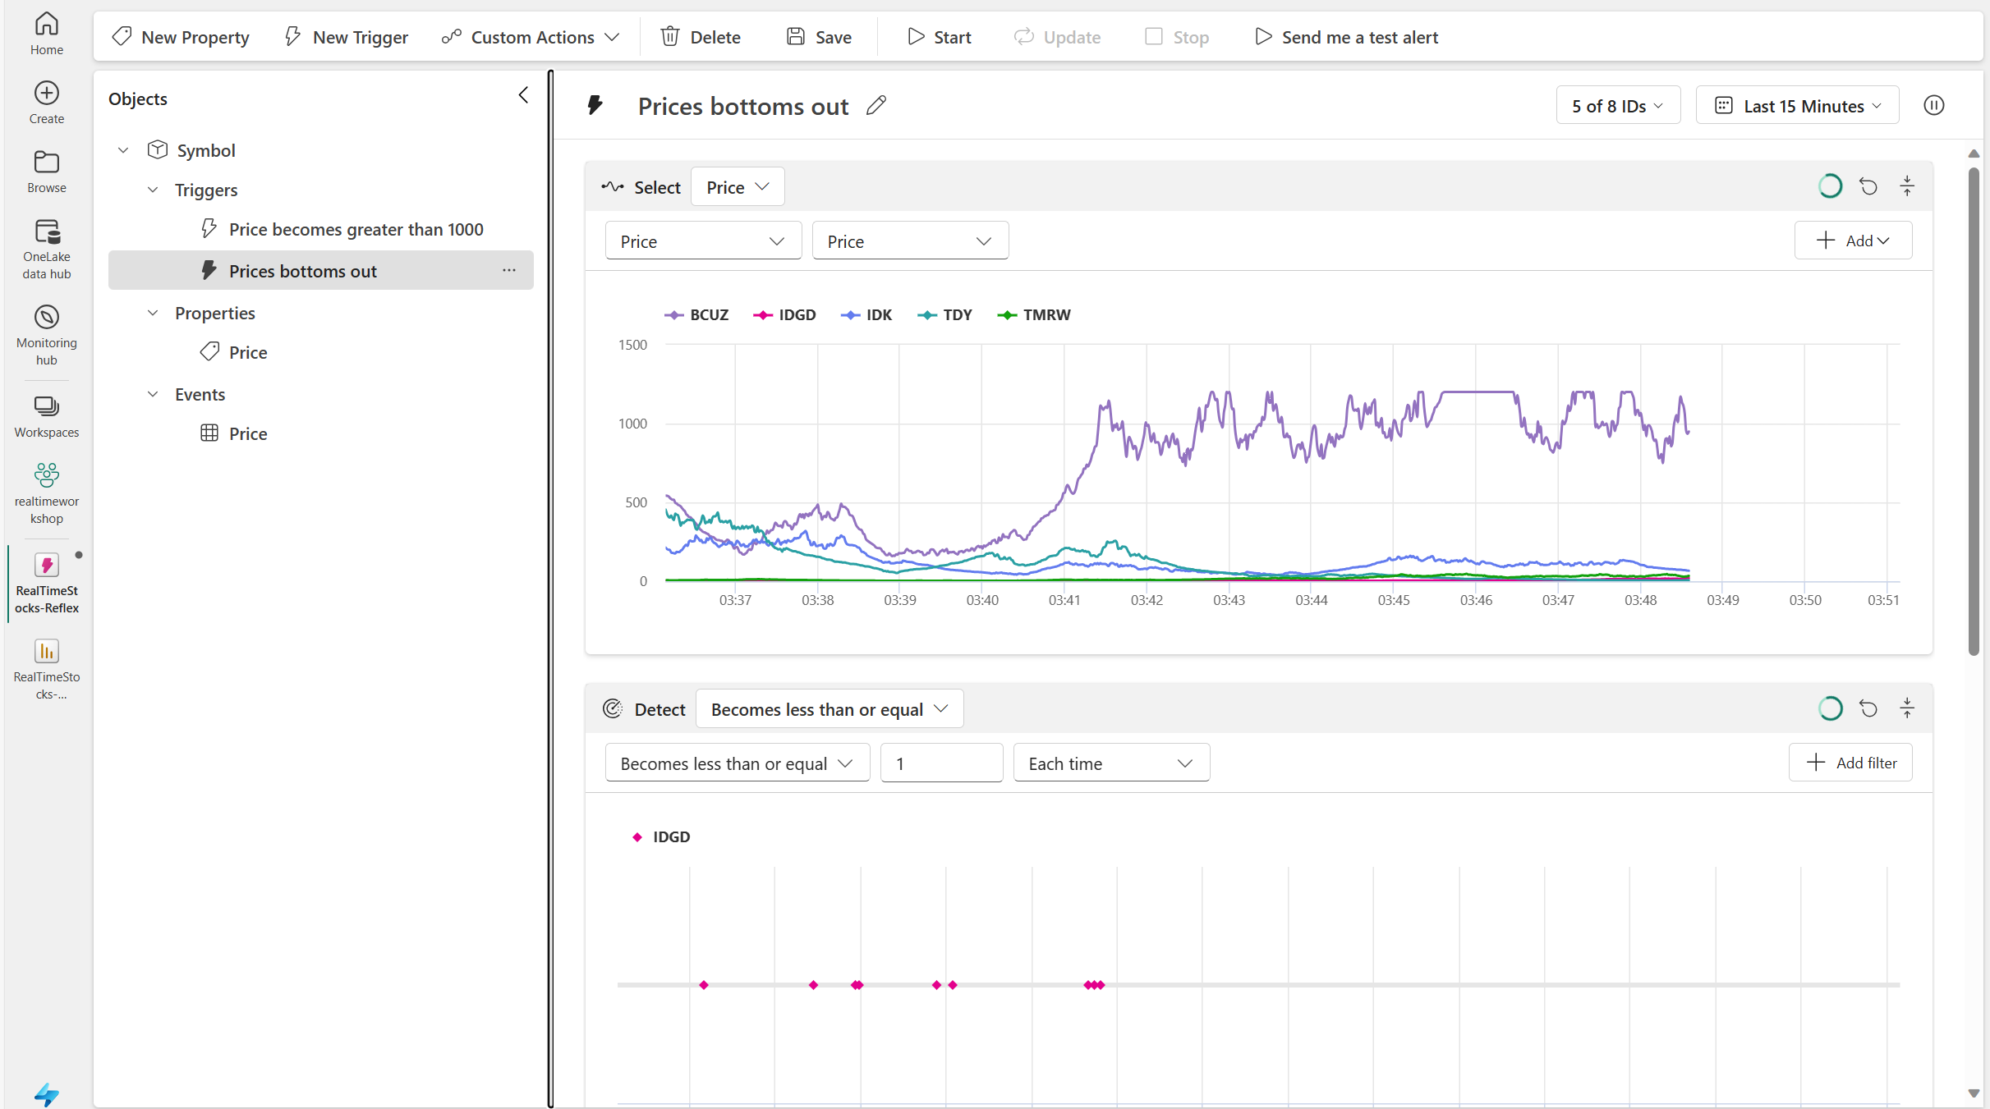
Module 4 – Data Activator
Goals: Configure alerting when prices reach certain levels.
This module will explore the configuration of Data Activator, an observability tool, to generate notifications when conditions in the underlying data are met.

Slide 19
Common Data Warehouse Patterns
Data Source
Ingestion
Store
Expose
Shortcut Enabled
Mounts
Data Warehouse
PBI
Structured / Unstructured
Pipelines & Dataflows
Warehouse
Transform
Procedures
Notes:
The Data Warehouse analytics scenario takes existing sources that are mounted, while pipelines and dataflows can bring in all other data that is needed.
IT teams can then define and store procedures to transform the data, which is stored as Parquet/Delta Lake files in OneLake.
From there, business users can analyze and visualize data with Power BI, again using the see-through mode or SQL endpoints.

Slide 20
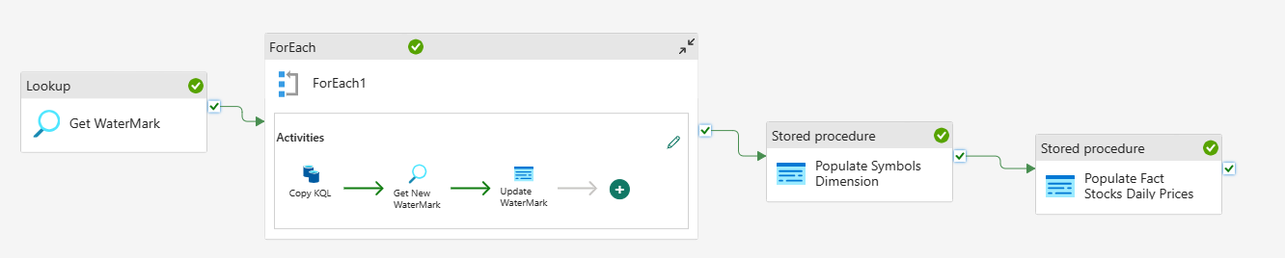
Module 5 – Data Warehouse
Goals: Build a dimensional model and data pipeline that stores aggregated data into a data warehouse.
Using the data warehousing capability, the data will be periodically loaded and summarized into a data warehouse for historic reporting. To accomplish this, we’ll use data pipelines for orchestration of an ETL pipeline.

Slide 21
Common Lakehouse Patterns
Data Source
Ingestion
Store
Expose
Shortcut Enabled
Shortcuts
Lakehouse(s)
PBI
Structured / Unstructured
Pipelines & Dataflows
Lake Warehouse
Transform
Notebooks & Dataflows
Notes:
The Microsoft Fabric Lakehouse analytics scenario makes it so that data can be ingested into OneLake with shortcuts to other clouds repositories, pipelines, and dataflows in order to allow end-users to leverage other data.
Once that data has been pulled into Microsoft Fabric, users can leverage notebooks to transform that data in OneLake and then store them in Lakehouses with medallion structure.
From there, users can begin to analyze and visualize that data with Power BI using the see-through mode or SQL endpoints.

Slide 22
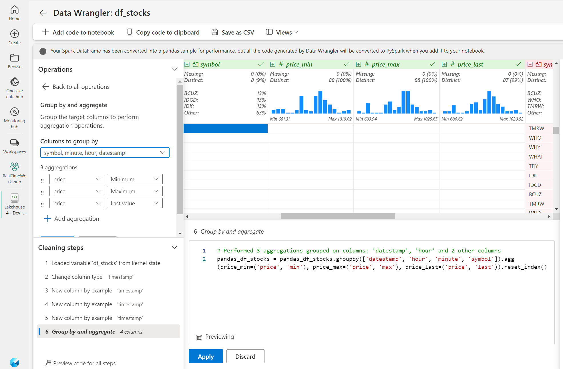
Module 6 – Data Lakehouse
Goals: Create a data lakehouse using data wrangler, notebooks, and Delta tables.
After modifying the Eventstream to copy data to the lakehouse, notebooks and data wrangler will be used to aggregate the data into tables that can be used for reporting and data science.

Slide 23
Common Data Science Patterns
Data Source
Clean & prepare
Store
Expose
Lakehouse & Data Warehouse
Notebooks
Lakehouse(s)
PBI
Train test & apply
Lake Warehouse
Models
Experiments
Notes:
The Data Science analytics scenario can be ingested similarly to the Lakehouse and Data Warehouse paths.
Once the data is ingested, it is cleaned and prepared using notebooks and then stored in the Lakehouse with medallion structure.
After the data is cleaned and stored, machine learning models can be trained and tested directly on the Lakehouse.
Like the other analytics scenarios, business users can analyze and visualize the data with Power BI using the see-through mode or SQL endpoints.

Slide 24
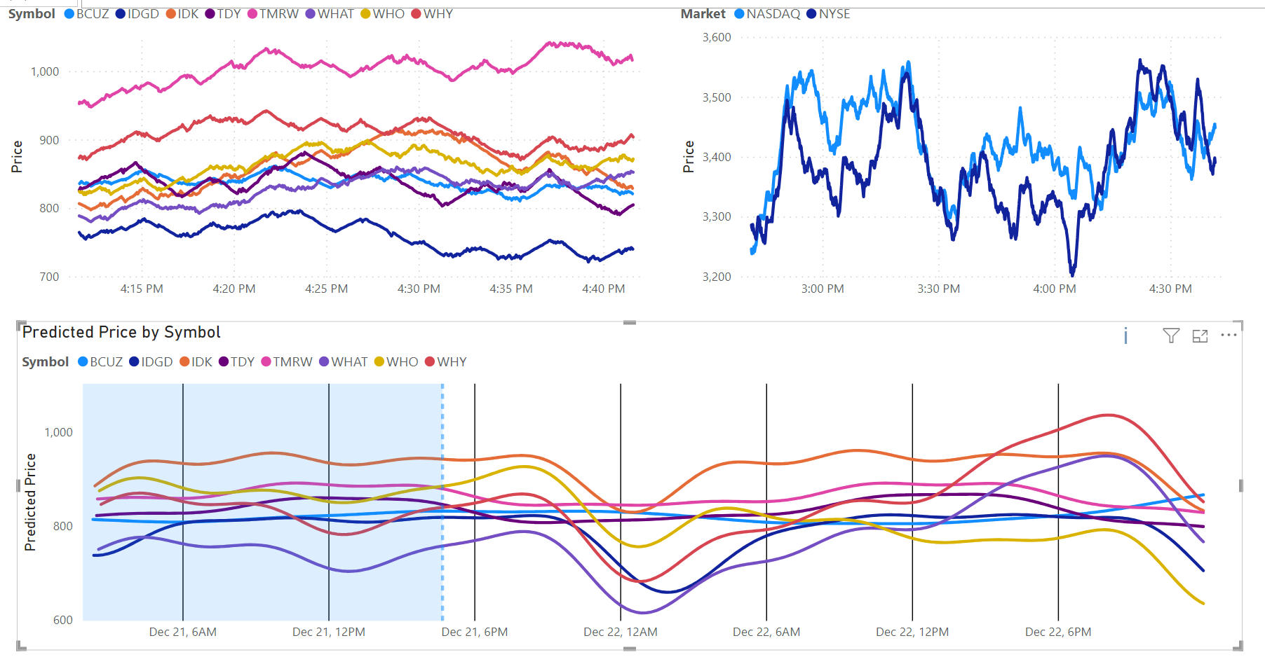

Module 7 – Data Science
Goals: Use notebooks to build an ML model predicting the stock prices.
Using the library Prophet, data will be analyzed allowing for future predictions. These predictions will be stored in the lakehouse and integrated into the reports.

Slide 25
Wrap-up, Q&A, & Feedback

Slide 26
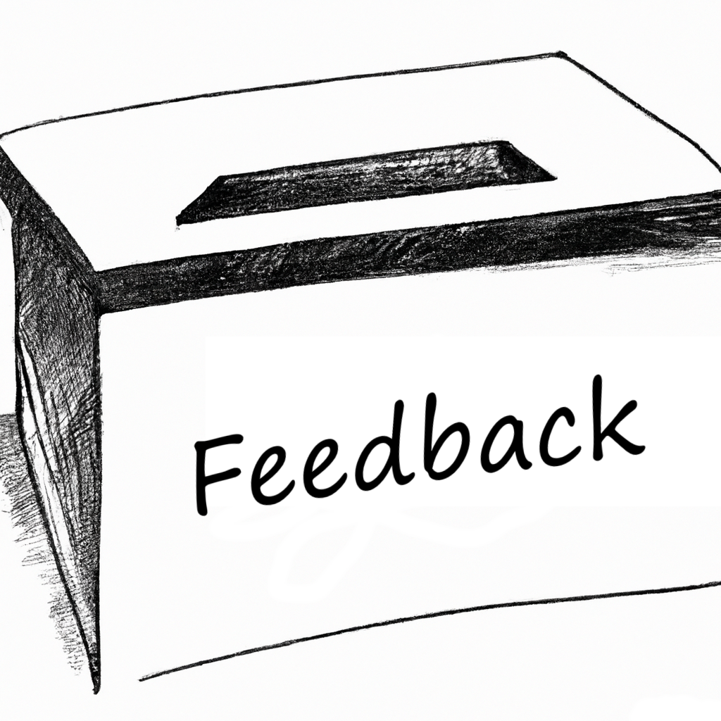
Wrap-up
Thank you for attending! Check out the additional challenges throughout the modules, and the Extras module with unique add-ons.
Comments or suggestions? Please let us know.
Get your questions answered in the Microsoft Fabric webinar series: https://aka.ms/fabric-webinar-series
See the latest announcements in the Microsoft Fabric blog site: https://aka.ms/fabric-tech-blog
Read the implementation guide: https://aka.ms/Getting-Started-eBook

